Slide 1
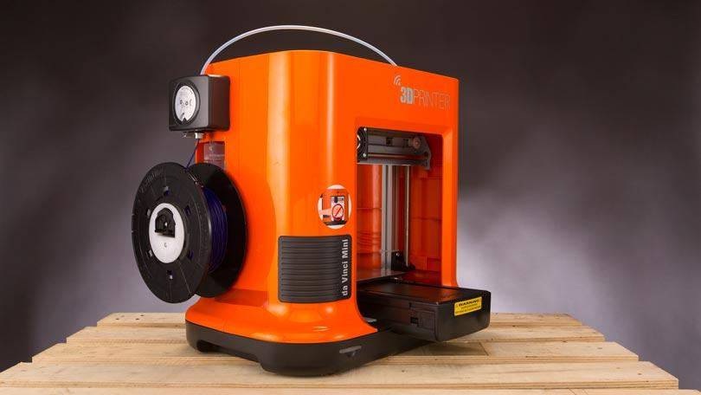
PrinTracker: Fingerprinting 3D Printers using Commodity Scanners
Authors:
Aditya Singh Rathore, Zhengxiong Li Sheng Wei Yanzhi Wang
Chen Song, Wenyao Xu Rutgers University Northeastern University
University at Buffalo

Slide 2
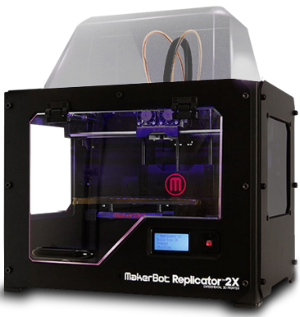
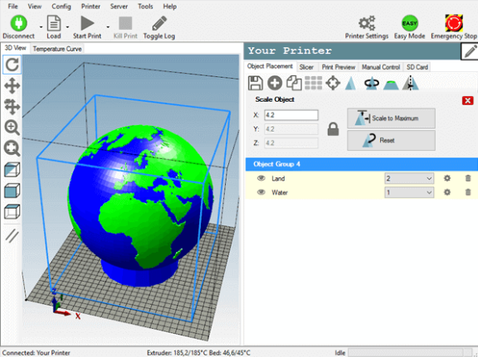
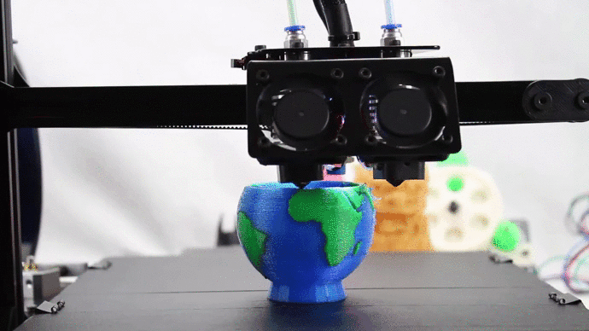
3d printing
Cyber Design
3D Printing
Physical Object

Slide 3
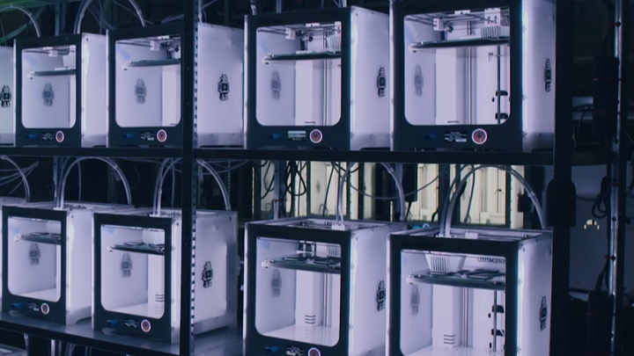
3D Printing Market
The industry expanded by more than $1.25 billion dollars in 2018!

Slide 4
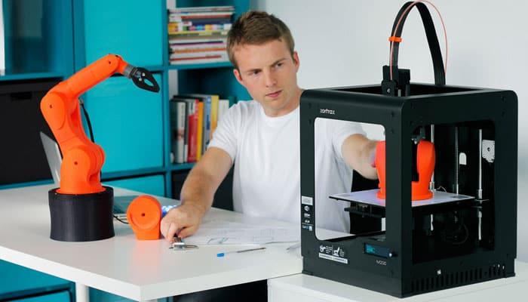
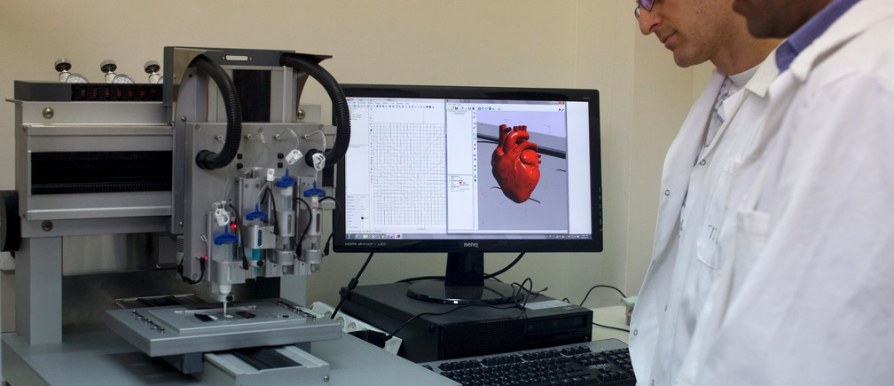
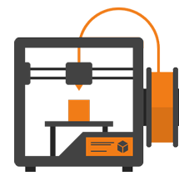
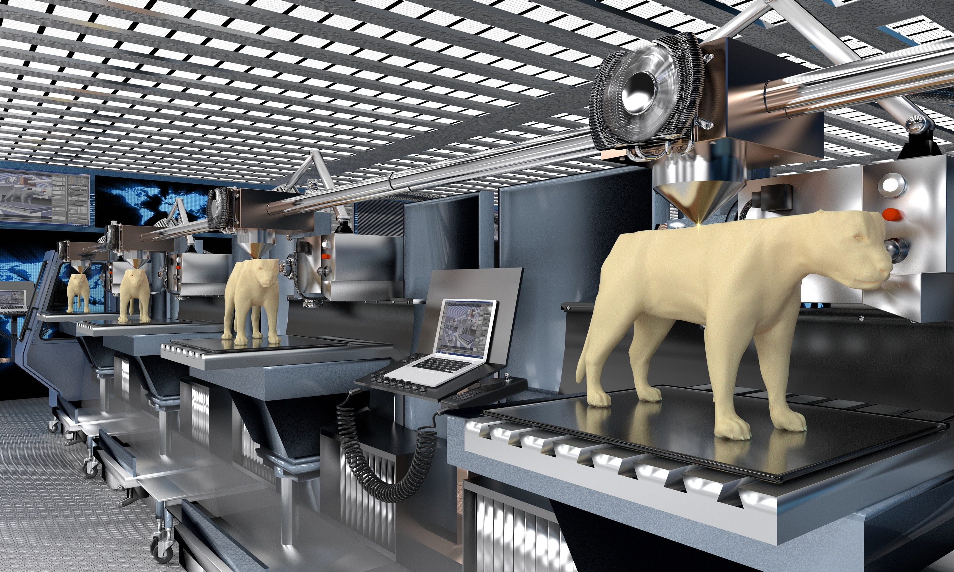
Advancement of 3d Printing
Automation
Medical
Efficient
Creative
Accessible
Personal
Commercial
4/24
Notes:
In the beginning, the distribution of 3D printers was imagined among thousands for personal fabrication.
Presently, millions of printers are used for automation and robotics, medical, personal and commercial applications.
The additive manufacturing industry has grown by more than $1.25 billion dollars in 2018.

Slide 5
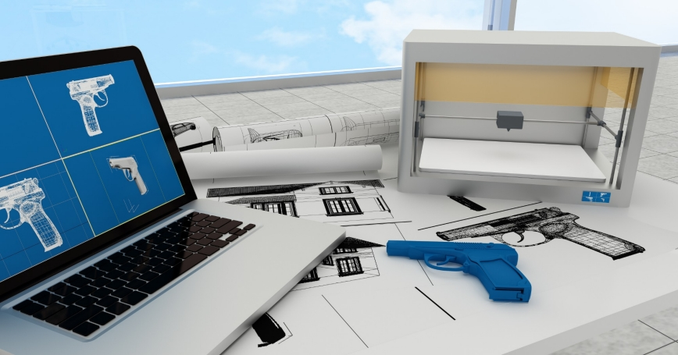
User: The new manufacturer!
Print anything, anywhere and without any supervision
5/24

Slide 6
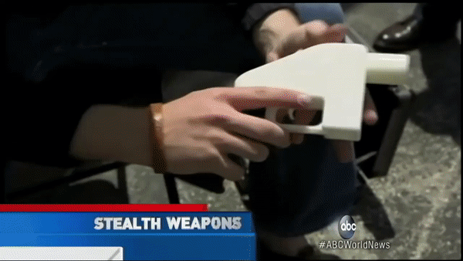
The rise of threats
Illegal Object Creation
Untraceable: No serial number nor background check.
Inexpensive: Compared to its marked cost.
Customizable: Allowing addition of illegal components (e.g., scope, automatic)
Source: ABC News, https://abcnews.go.com/WNT/video/3d-printed-guns-pose-threat-gun-law-expires-20919257
6/24

Slide 7
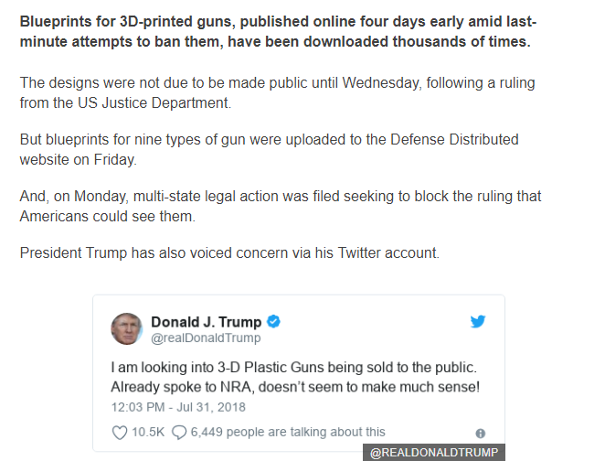
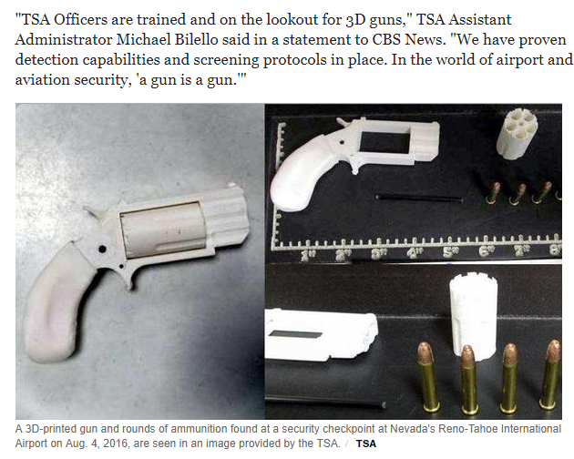
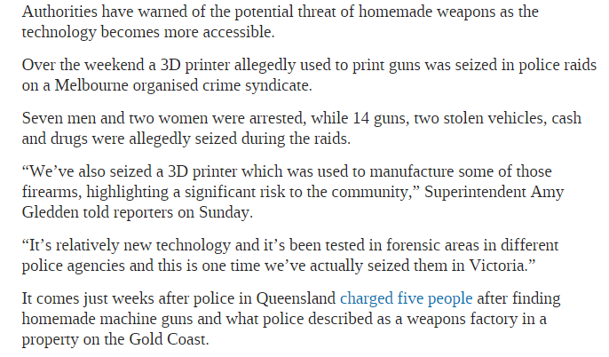
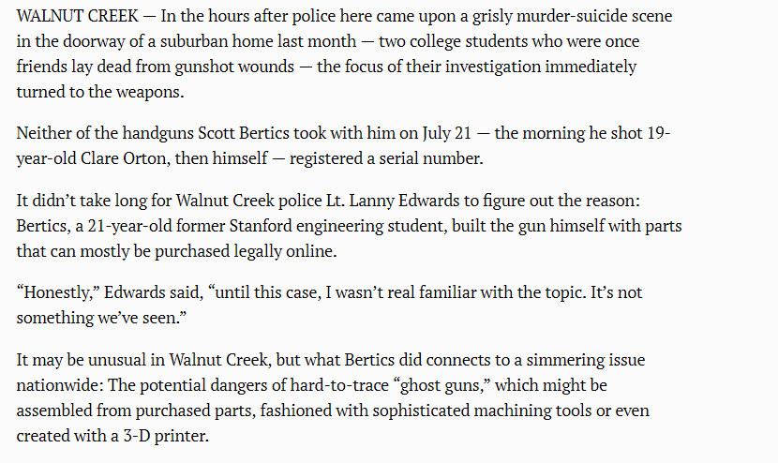
Thousands download 3D-printed gun design
3D-printed guns among weapons found at airport security checkpoints, TSA says
Police seize another batch of 3D printed guns as authorities deal with danger of downloadable firearms
Homemade gun in Stanford student’s murder-suicide spurs question on ‘ghost guns’
Life-threatening Consequences!
Notes:
1. https://www.bbc.com/news/technology-45018513
2. https://www.cbsnews.com/news/3d-printed-guns-among-weapons-found-at-airport-security-checkpoints/
3. https://www.news.com.au/technology/innovation/design/police-seize-another-batch-of-3d-printed-guns-as-authorities-deal-with-danger-of-downloadable-firearms/news-story/c2fa2711ebf7b761e3e2f0802a80d1b2
4. https://www.mercurynews.com/2015/08/06/homemade-gun-in-stanford-students-murder-suicide-spurs-question-on-ghost-guns/

Slide 8
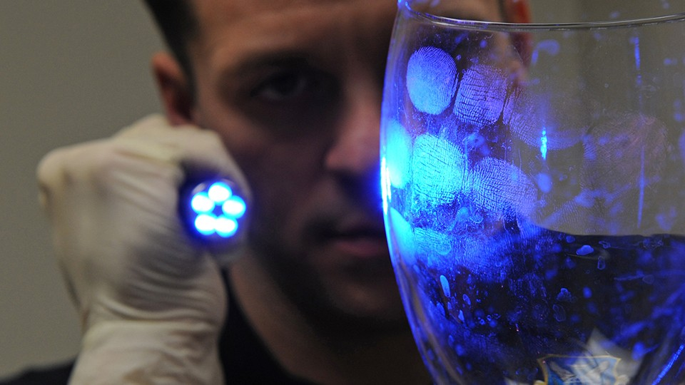
Ideal scenario
In traditional setup, the fingerprint of an adversary can identify him/her.
The product contains a unique fingerprint derived from its source 3D printer.
The fingerprint is pertinent to all 3D printed products universally.
Works for existing 3D printers without any modifications.
8/24
Notes:
Lets consider an ideal scenario
In a traditional forensic investigation, the fingerprint of adversary can be retrieved for identification. However, adversary can take precautions to leave no fingerprint.
When this is applied to 3D printing domain, the 3D product should contain fingerprint that identifies the source.
Furthermore, the fingerprint is present on all objects and works for all existing 3D printers without any modifications.

Slide 9
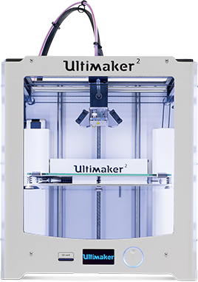
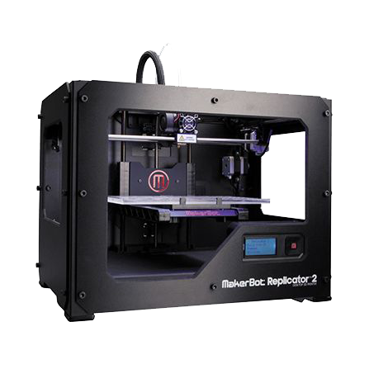
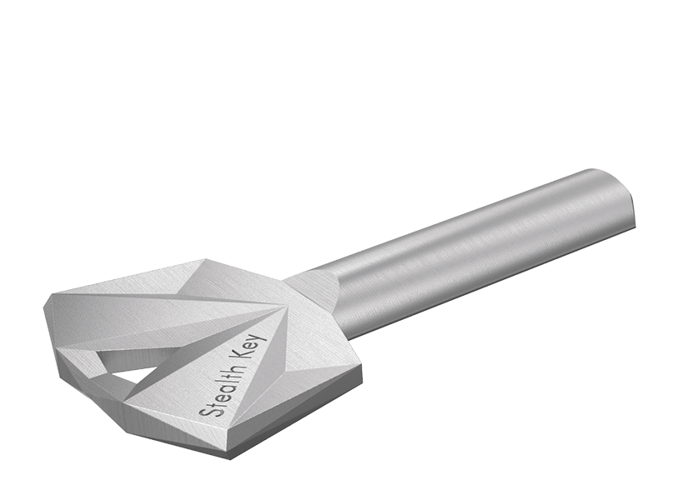
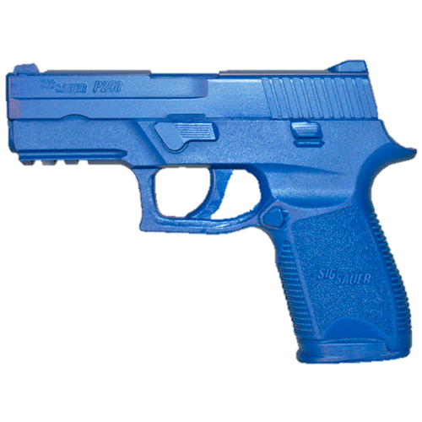
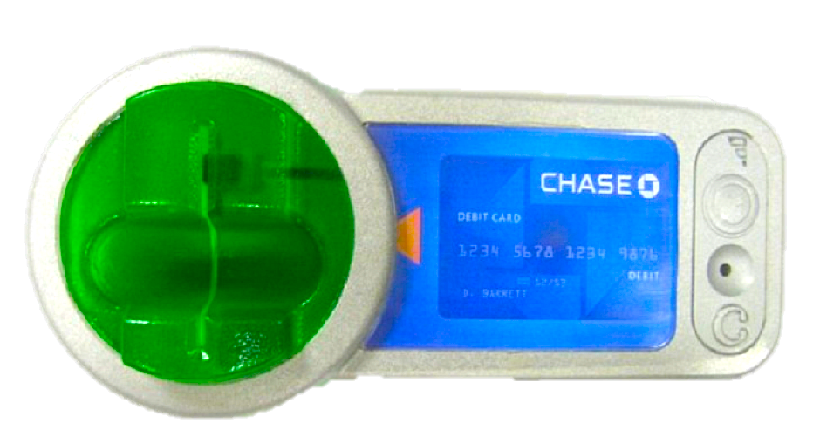
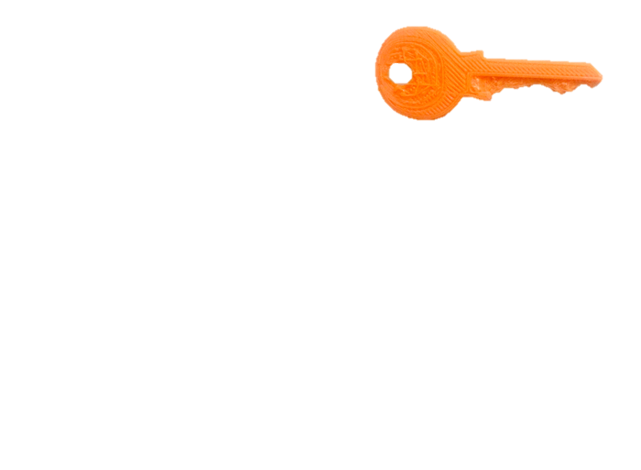
Our Vision
3D printer would possess a unique fingerprint.
Fingerprint is universal and cannot be spoofed by attackers.
Distinct Features
Common Features
Common Features
9/24
Notes:
We envision that every 3D printer should possess a unique fingerprint.
The fingerprint from objects fabricated from similar printer would have common features while distinct features are present in different products from different printers.
It should be universal, but more importantly cannot be spoofed by attacker.

Slide 10
Putting it together
Basic Idea of our system: PrinTracker
10/24
Notes:
The illegal object is obtained during the forensic investigation.
The forensic team analyzes the fingerprint using our proposed system to generate a printer ID which matches the printer owned by the attacker. This information can be used with other evidences to identify the attacker.

Slide 11
Is the fingerprint really present?
CMOS process variations have been used for silicon device identification.
Concise signature is present on each paper for document identification.
[Ingrid Verbauwhede, ACM Great Lake Symposium on VLSI, 2011]
[William Clarkson, IEEE Symposium on Security and Privacy (S&P), 2009]
Wouldn’t it be nice if similar process variations exists for 3D printers too?
Challenge: 3D printer comprises of numerous hardware interactions!
11/24
Notes:
Now a question that some of you might be thinking is that is the fingerprint really present?
Previous studies show that CMOS process variations can be used for silicon identification.
Similarly, each document comprises of concise signature.

Slide 12
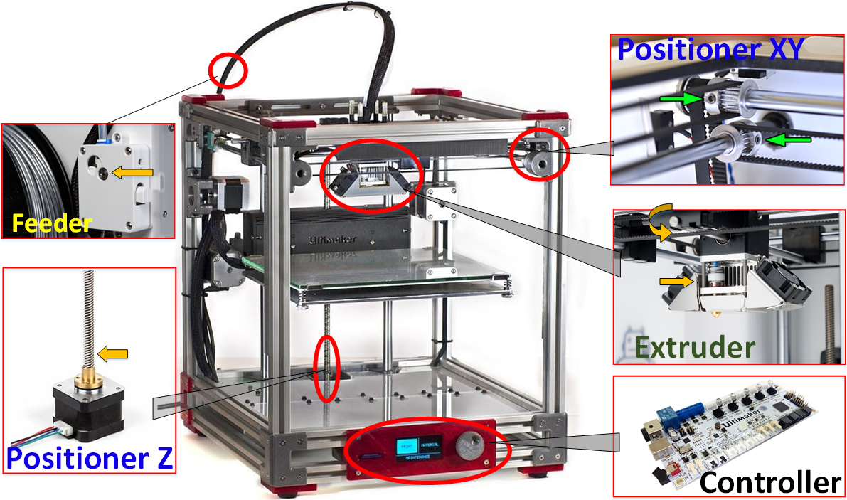
Hardware Imperfections exists!
Tension
$$P_{w}=T_{t}−T_{s}=T_{tt}−T_{ss}$$
$$T_{tt}=T_{t}+\frac{(λ_{1}+λ_{2})S_{c}ε}{l_{1}+l_{2}}$$
$$∆x_{p}=\frac{(λ_{1}l_{2}−λ_{2}l_{1}) }{l_{1}+l_{2}}$$
$$∆θ=\frac{2π∆x_{p}}{t_{p}z_{p}}$$
Torque constant
$$u_{1}=Ri_{1}+L\frac{di1}{dt}−K_{m}ωsin\left(Nθ\right)$$
$$u_{2}=Ri_{2}+L\frac{di2}{dt}−K_{m}ωcos(Nθ)$$
Pulley Movement
$$K_{m}\left(−i_{1}\sin\left(Nθ\right)+i_{2}\cos\left(Nθ\right)\right){−T}_{L}=J\frac{dω}{dt}+K_{v}ω$$
$$ω=\frac{dθ}{dt}$$
Coeff. of heater power
System Inertia
$$T= ηPID\left(T_{1}−T_{0}\right)$$
$$T1=αρT$$
$$W∝kωT$$
Volumetric flow
12/24
Notes:
Here is a general architecture of 3D printer. The three primary components are feeder (to feed material), positioner to control movement, and extruder to release the melted filament.
In the feeder, the variations in torque constant affects the system inertia.
The tension of transmission belt affects the pulley movements.
While in the extruder, the coefficient of heater power affects the volumetric flow.

Slide 13
Integrated Effect
Object Skin
Design
Unsteady Volumetric Flow
Variations in line trajectory vector and platform positioning
Object Outline
Design
Irregular material fusion
Unsteady extrusion
13/24
Notes:
To summarize, feeder....positioner....extruder.....
Combining them, the integrated effect leads to varying line diameters and intervals both on the surface and the outline of printed object.
This is evident, when compared to the design file.
This proves that the hardware variations lead to minute deformations in the texture that are inevitable and consistent.

Slide 14
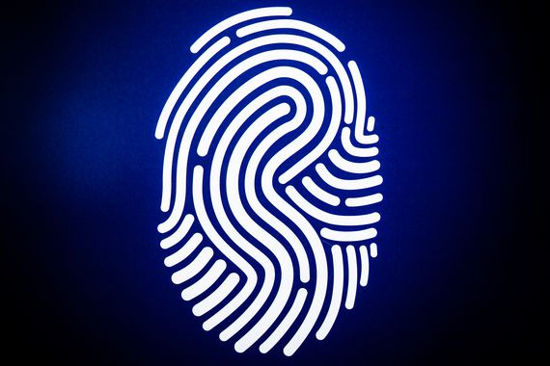
Modeling the fingerprint
Acquisition of textures is independent and universal.
Sampling window and location is not specific.
L1
L2
3D Object
L3
Banding Texture
14/24
Attachment Texture
Notes:
The texture patterns that are typically observed on 3D objects surface can be categorized in four types, bifurcated, short, wide rugged/curved. These major minutia features forms the banding texture.
Similarly, the edge of the object appears as discontinuous and continuous, irregular or regular or comprises air bubbles which forms attachment texture.
The aggregated characteristics of these textures can be considered as unique fingerprint of 3D printer.
These textures are obtained independently and universaly with no specific sampling window or location.

Slide 15
ID Provenance Method
Commodity Scanners
Texture Analysis
Printer Identification
Non invasive characteristics.
Ease of operation.
Will the luck always be in the favor of forensic team?
15/24
Notes:
Initially, the surface of printed objects is scanned using a commodity scanner. The texture information is analyzed from the overall spatial pixel relations in the image.
Gray Level Co-occurrence Matrix (GLCM) is used to estimate the probability density of pixels in image and derive a set of statistical features.
These 20 features are used to for fingerprint identification using SVM classifier.

Slide 16
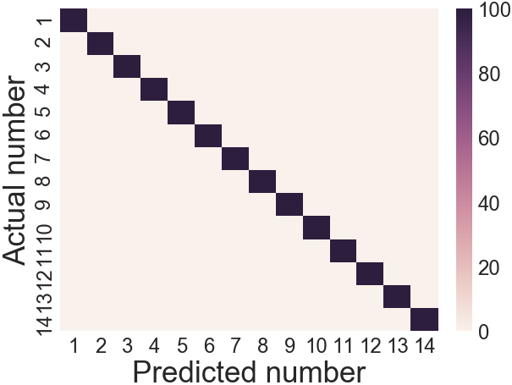
What if only one texture is availabl-e?
WHAT IF ONLY ONE TEXTURE IS AVAILABLE?
OR
OR
OR
OR
Banding Texture
Attachment Texture
Accuracy = 92.20%
Accuracy = 100%
The sampling area can be as small as 4mm²!
16/24
Notes:
It is not uncommon that only a minute part of object can be retrieved from crime scene.
The object may only contain information about a single texture.
Thus we analyze performance of both texture individually....
The lower accuracy in banding texture is due to nature of our algorithm which statistically describes the textures based on interleaving of filaments, rather than visual characteristics.

Slide 17
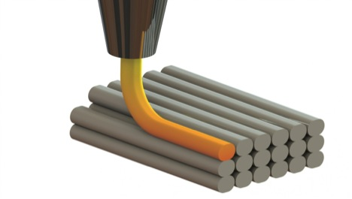
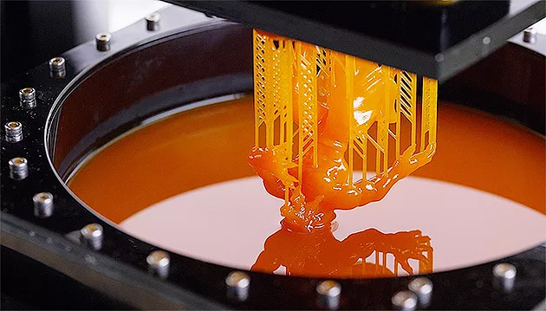
What if the printer is not identifi-ED?
WHAT IF PRINTER IS NOT IDENTIFIED?
Fused-Deposition Modeling (FDM)
Stereolithography (SLA)
 |  | Predicted
 |  | FDM | SLA | Recall
Actual | FDM | 997 | 3 | 99.70%
 | SLA | 0 | 400 | 100%
 | Precision | 100% | 99.26%
Can provide the auxiliary information to use with other evidence!
17/24
Notes:
Consider a rare case where the printer cannot be precisely identified.
Each printer has a type based on its functioning.
From our evaluation, PrinTracker can identify the type with accuracy close to 100%.
This narrows down the scope of the investigation...

Slide 18
Can the fingerprint be spoofed?
18/24

Slide 19
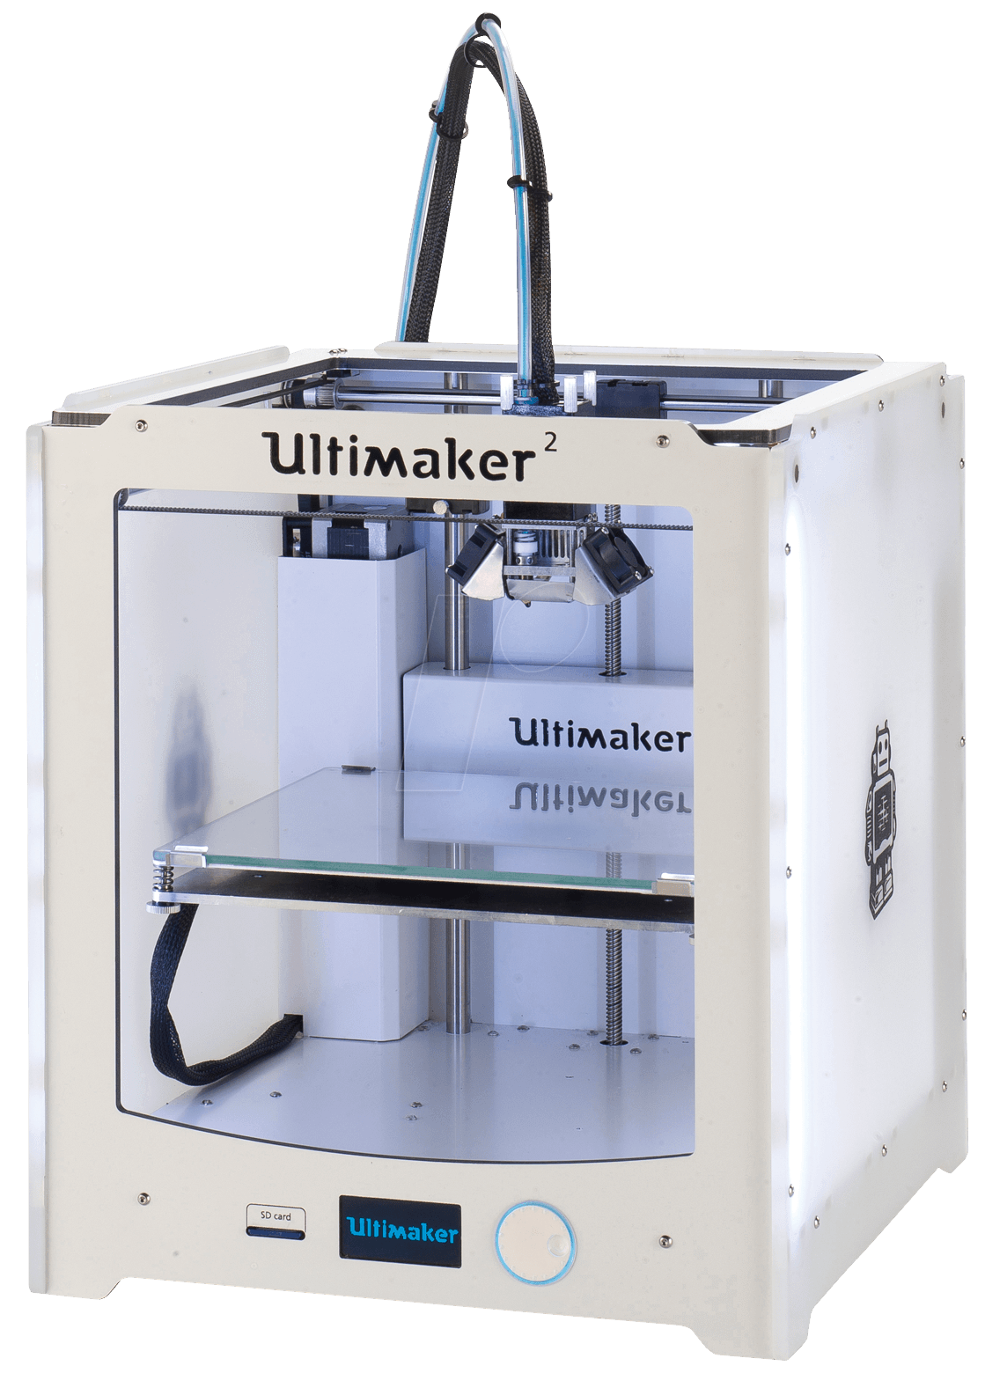
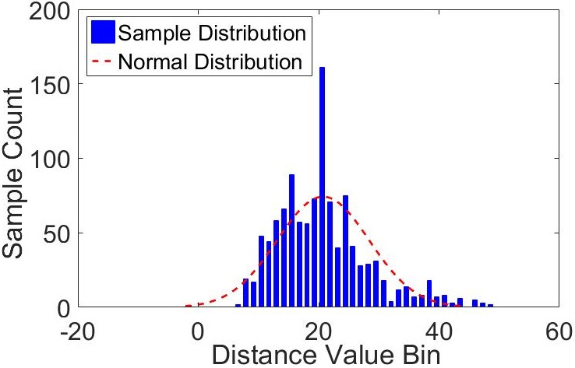
What if attacker obtains similar 3D printer? (1/3)
Authorized printer’s fingerprint is stored in database
Lucky attacker finds similar printer
Database
Attack results in failure
Feature Value is randomly distributed
PrinTracker can identify among even printers of same type!
19/24
Notes:
The attack results in a failure because the feature values are randomly distributed. Moreover, our system can even identify among printers of same type and model.

Slide 20
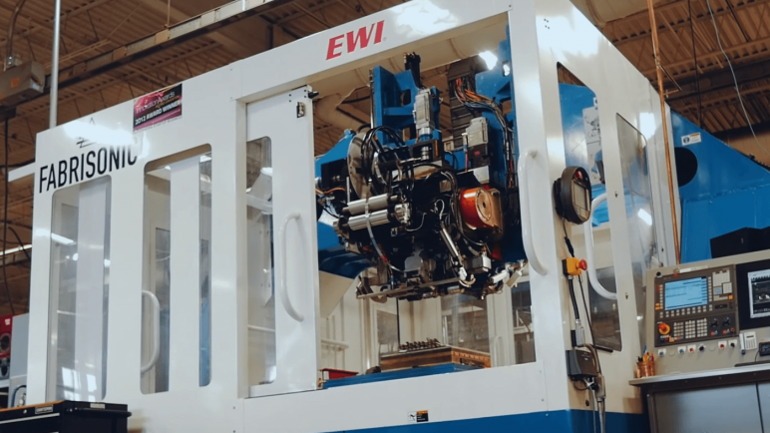
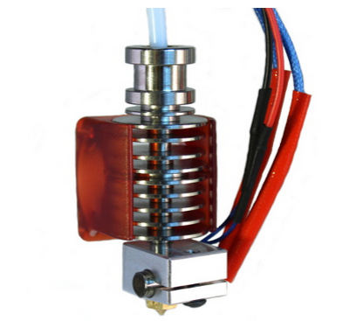
What if attacker obtains the specifications? (2/3)
Economically unfeasible.
Simulating the texture pattern is difficult.
Experimental Result: The new fingerprint is classified as not authorized.
Fingerprint generates from complex integrated effect.
Requires many components and trial and errors.
Original
Authorized
20/24
Notes:
What if the attacker happens to obtain the specifications of the authorized printer and decides to morph the fingerprint to authorized one?
He can utilize an advanced printing machine, however such a machine costs millions of dollars and simulating the texture is difficult due to hardware interactions.
He can also replace the component of 3D printer with something else. In our experiment...

Slide 21
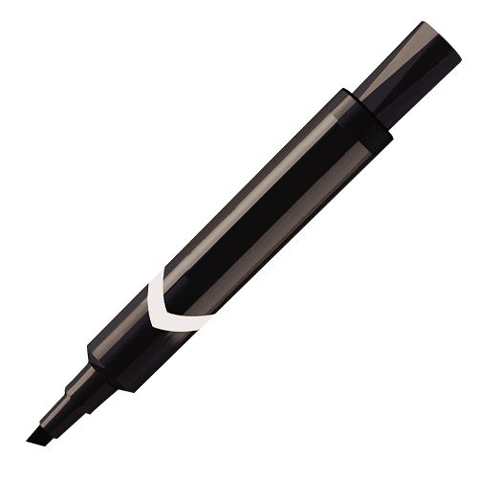
Before leaving the crime scene… (3/3)
Accuracy is close to 100%.
Ideal
Alcohol can effortlessly clean surface.
Cleaned surface works same as ideal.
Scribbling
The accuracy remains as 100%.
To work, each texture feature (0.4mm diameter) needs to be destroyed.
Scratching
Requires intensive time effort.
Several inner layers possess the same fingerprint as the top layer!
Heating
21/24
Notes:
In the final attack scenario, the attacker thinks that if he compromise the texture on the object, he cannot be traced.

Slide 22
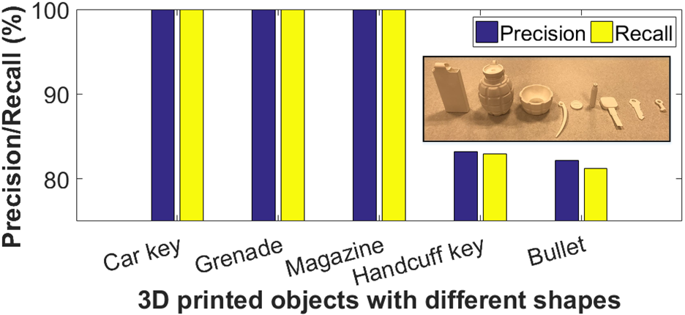
Can we do better?
Complication from curved geometry:
Age effect: Perform experiments with longer period (>1 year).
Large Scale Evaluation: Database comprising 14 professional 3D printers, three commodity scanners, hundreds of fabricated sample is released.
Counterfeiting: Further explore the scalability of the system.
High-definition 3D scanner results in 94% accuracy.
22/24

Slide 23
Conclusion
A new fingerprint exploration: The insights for modeling hardware variations can be explored for other cyber-physical systems.
A novel identification framework: Comprising texture-based analysis for identification of specific printer or its type.
An end-to-end forensic system: Presented real-world scenarios to evaluate the effectiveness, reliability and robustness that can be used for future research.
23/24

Slide 24
Thank you!
Website will be posted here.
24/24

Slide 25
Advancement of 3d Printing
Automation
Medical
Benefits:
Efficiency
Creativity
Accessibility
The industry expanded by more than $1.25 billion dollars in 2018!
[Ian Campbell, Wohlers report: 3D printing and Additive Manufacturing State of Industry, 2018]
Provides freedom to user to enact as manufacturer!
What about security?
Personal
Commercial
Notes:
In the beginning, the distribution of 3D printers was imagined among thousands for personal fabrication.
Presently, millions of printers are used for automation and robotics, medical, personal and commercial applications.
The additive manufacturing industry has grown by more than $1.25 billion dollars in 2018.

Slide 26
How to protect against such threats?
Limit its accessibility?
Restrictions by International Traffic in Arms Regulations (ITAR) have varying efficacy.
Information embedding?
Attacker can easily access the 3D printer, including design files, without external supervision.
Defense Software?
Millions of 3D printers in the market and user locations, needs to be replaced or updated.
Notes:
What are the ways to protect against such threats?
The laws by ITAR for limiting profileration of illegal 3D objects have varying levels of effictiveness.
The attack possess access to 3D printer and product’s design.
Millions of 3D printers that are already been deployed needs to be replaced, unfeasible in real-practice.

Slide 27
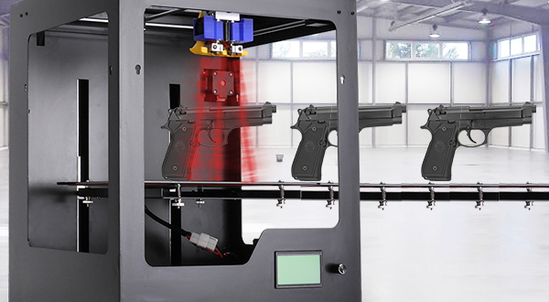
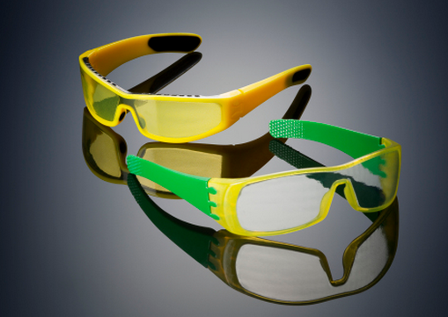
The Rise of Threats
Illegal Object Creation
Counterfeiting
Untraceable: No serial number nor background check.
Inexpensive: Compared to its marked cost.
Customizable: Allowing addition of illegal components (e.g., scope, automatic)
Life-threatening Consequences!
Intellectual Property Loss: Compromising integrity.
Sabotaged Objects: Causing financial loss.
Notes:
One of the main threat to 3D printing domain is illegal object creation.
This is because the adversary can create untraceable objects which are low-cost compared to market price and can be customized to add components, generally restricted by law.
Another threat is counterfeiting which leads to compromised integrity of users and substancial loss to financial assets.

Slide 28
Benefits of 3d printing
Efficiency: Fast and low-cost production with less material waste.
Creativity: Flexible with complex geometric construction using CAD tools.
Accessibility: Affordable price of printers and materials.
Provides freedom to user to enact as manufacturer!
What about security?
Notes:
Compared to traditional manufacturing, 3D printers owns superiorities due to fast and low-cost fabrication, customizability and accessibility due to its affordable price.
It has transformed the manufacturing industry by providing user the freedom to enact as manufacturer and produce any object with no external supervision.
But what about security?

Slide 29
Contributions
Briefly,
First investigation of a 3D printer's fingerprint.
Implement an end-to-end 3D printing forensic system, PrinTracker.
Demonstrate the resilience of PrinTracker.
Notes:
Modeling the intrinsic connection between the printer hardware imperfections and the textures on the associated printed product. This is unexplored in 3D printing domain.
an immediately deployable solution and pertinent to 3D printed objects universally and economically.
against multiple attacks with varying threat levels.

Slide 30
Agenda
Motivation
Threat Model
Methodology
Texture Characterization
System Overview
Fingerprint Analysis
Printer Identification
Performance Analysis
Attack Evaluation
Future Work and Challenges

Slide 31
Motivation: the Advent of 3D printer security
Rise of 3D Printers
Growing Threats:
Counterfeiting/Illegal Production
Ability to identify source printer will be significant
Products from (1) same printer common features in their fingerprint. (2) different printer distinct features in their fingerprint.
Impossible to Identify attacker?
Advantages to Attackers
Limited Solutions

Slide 32
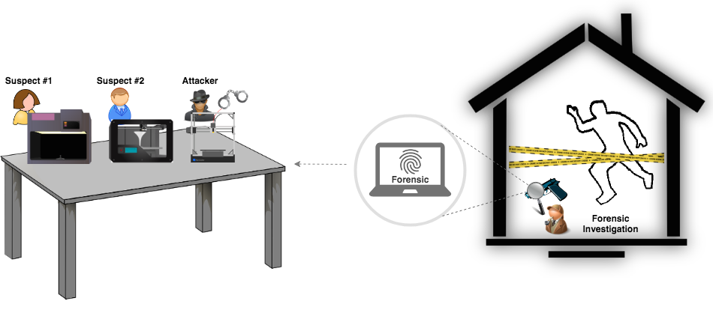
Threat model: Identifying attackers through fingerprint
Showing the forensic scene

Slide 33
Methodology: Texture Variations from hardware imperfections
Factors Affecting Object Texture
Equation #1
Unsteady volumetric flow
Part #1: Feeder
3D Printer
Equation #2
Line tracjectory vectors
Platform positioning
Part #2: Positioner
Equation #3
Irregular material fusion
Unsteady extrusion
Part #3: Hot End

Slide 34
Texture characterization: Modeling Fingerprint on Object surface

Slide 35
System overview: using fingerprint to identify 3d printers

Slide 36
What if attacker obtains similar 3D printer? (1/3)
Authorized printer’s fingerprint is stored in database
Lucky attacker found similar printer
The attack results in failure
Database
Feature Value is randomly distributed
PrinTracker can identify among even printers of same type!
36/24
Notes:
The attack results in a failure because the feature values are randomly distributed. Moreover, our system can even identify among printers of same type and model.

